Slide 1













MUHAMMAD ABDULLAH ISMAIL
HIGHSCORE 2500
MAHIRA ALI
ARCADE HUB
Create an interactive gaming hub with captivating
features and competitive gameplay.

Slide 2











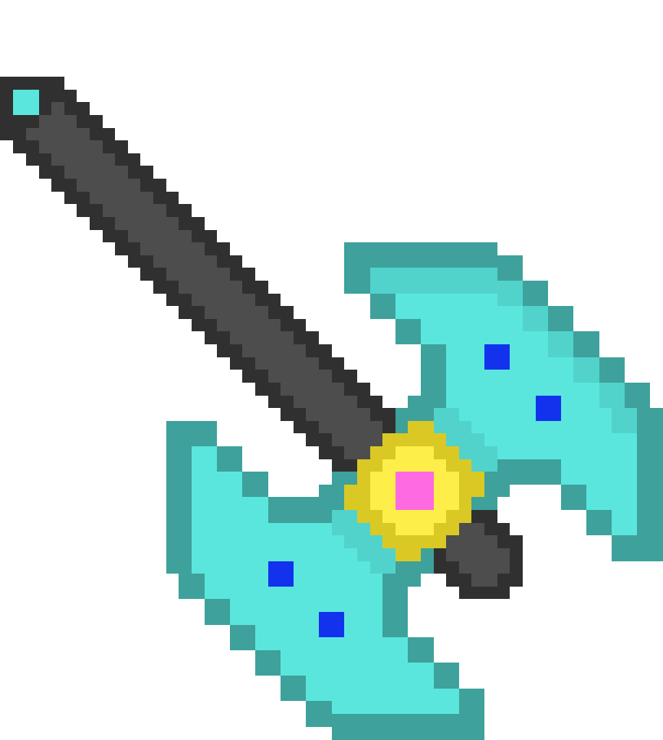


01
07
12
KEY FEAYTURES
Diverse Mini-Games
Leaderboard System
progressive Gameplay
Exportable Scores
Include Geo Guesser, Problem Solver,
and Hangman.
Foster competition with global
and local scoreboards
Adjust game difficulty based on player performance.
Enable players to share
achievements.

Slide 3

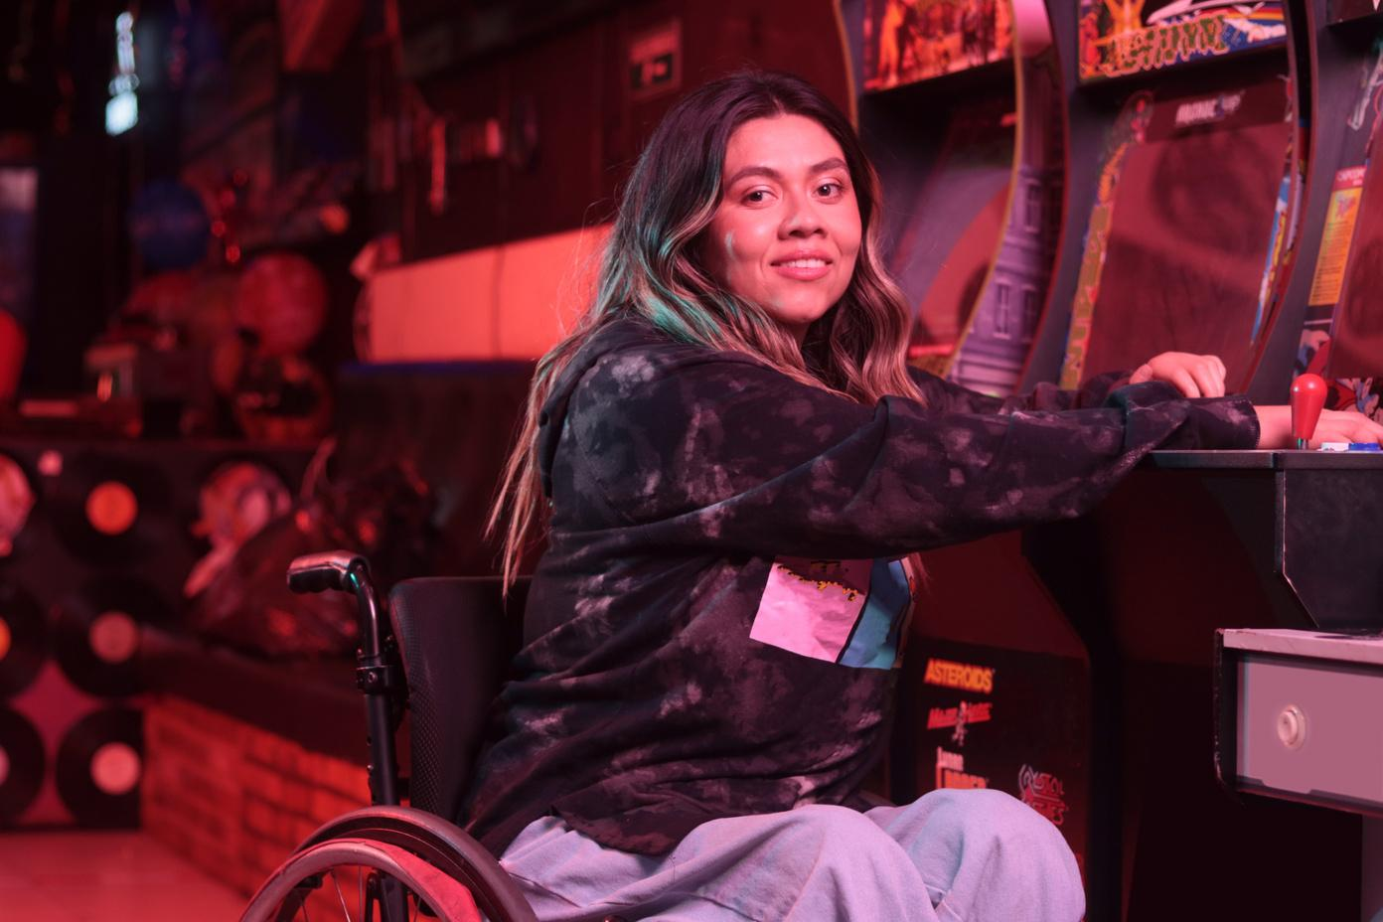

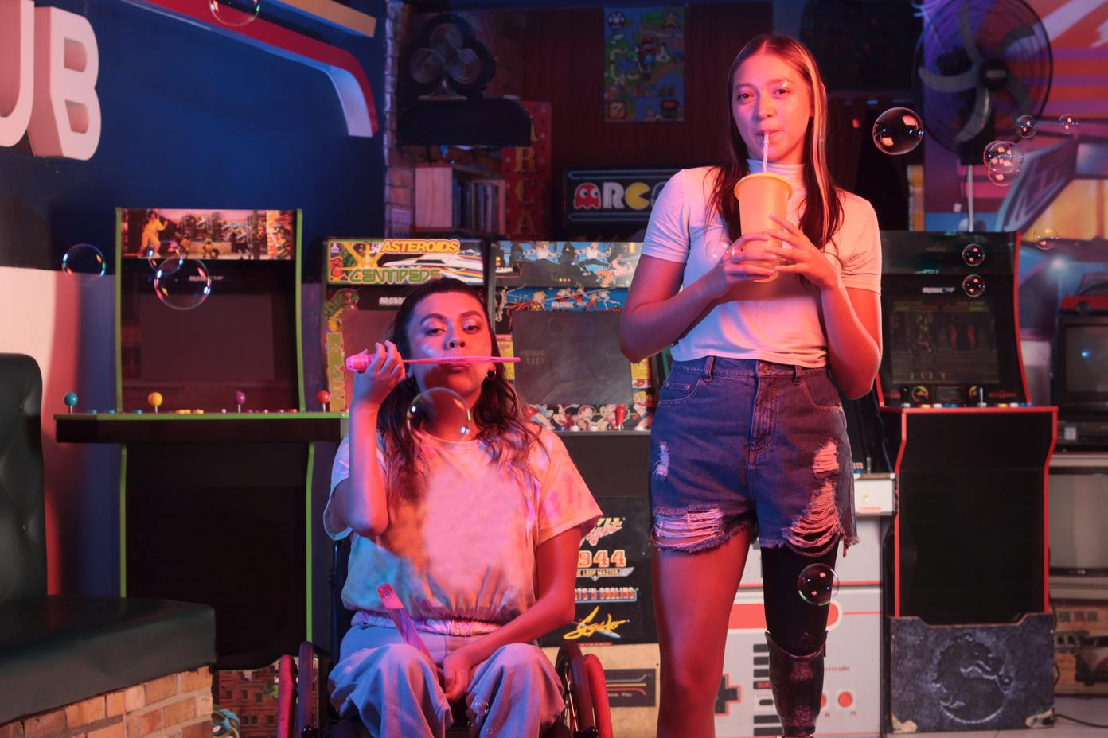

Programming Language
C++ for core development.
CORE TECHNOLOGIES
Libraries
Libraries like algorithm, fstream and vectors etc were used .
Development Tools
Embarcadero Dev-C++
Back to purpose page

Slide 4

01
07
12
USER EXPERIENCE
Intuitive Interface: Simplified navigation and user-friendly design.
Engaging Gameplay: Dynamic challenges and Captivating elements.
Back to
key feauture Page

Slide 5











Back to Purpose Page
TARGET AUDIANCE
Casual gamers of all ages

Slide 6














SIGNIFICANCE
It offers an engaging platform that combines fun, learning, and competition, encouraging user retention.

Slide 7

HIGHSCORE 2500
PLAYER 2
BALANCING GAME DIFFICULTY:
IMPLEMENT ADAPTIVE DIFFICULTY ALGORITHMS.
CHALLENGES & MITIGATION
MEMORY OPTIMIZATION:
USE EFFICIENT DATA STRUCTURES.
Back to Purpose Page

Slide 8
Back to Purpose Page
01
07
12
Introduce a GUI.
FUTURE ENHANCEMENT
Expand the game library.
Integrate advanced graphics and animations.

Slide 9






SCALABILITY
Designed for easy integration of new games and features.

Slide 10
THANK YOU!
MUHAMMAD ABDULLAH ISMAIL (F2024-0305)
MAHIRA ALI (F2024-0144)

